Slide 1
Real-Time Systems Design
Chapter 9

Slide 2
Lesson Objectives
Introduce some terms related to real-time system
Describe the design process for real-time system

Slide 3
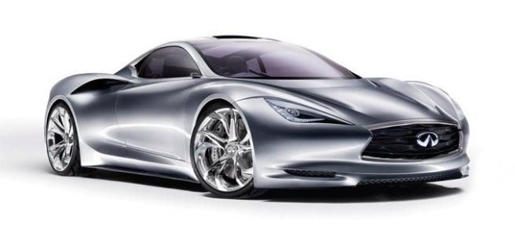

Real-Time System
Result produced
Correct Functioning
Timing

Slide 4
Real-time System
A real-time system is a software system whose correct functioning depends on the results produced and the time at which these results are produced.
Example: air traffic control systems, process control systems, and autonomous driving systems.

Slide 5

Real-Time System
Operation degraded
“Soft” Real Time System

Slide 6

Real-Time System
Operation is incorrect
“Hard” Real Time System

Slide 7
Real-time System
A "soft" real-time system is a system whose operation is degraded if results are not produced according to the specified timing requirements.
Example?
A "hard" real-time system is a system whose operation is incorrect if results are not produced according to the timing specification.
Example?

Slide 8

Stimuli of Real Time System
Event/
Stimuli
System Change States

Slide 9
Stimuli of Real Time System
System Change States
State Machine Modeling

Slide 10

Stimuli of Real-time System
Real-time systems have to respond to events occurring at irregular intervals. These events (or stimuli) often cause the system to move to a different state.
Thus, may be used as a way of describing astate machine modeling real-time system.

Slide 11
Stimuli of Real-time System
A state model of a system assumes that, at any time, the system is in one of a number of possible states.
An example of state model of a simple microwave oven, extracted from the text book.

Slide 12
Stimuli of Real Time System
Full Power On
Timed Operation
Time out
Cooking Complete
Half Power
Start
Timer
Full Power
Door Closed
Operation Enabled
Set Time
Idle
Idle
Half Power
Timer
Door Opened
Door Opened
Full Power
Half Power On
Operation Disabled
State Machine Model of a Microwave Oven

Slide 13
Stimuli of Real Time System
Real Time System
Stimulus/Response System

Slide 14
Stimuli of Real Time System
1. Periodic Stimulus
2. Aperiodic Stimulus
Two classes of Stimulus

Slide 15
Stimulus/response System
One way of looking at a real-time system is as a stimulus/response system.
Stimuli fall into two classes: -
1) Periodic stimuli
– These occurs at predictable time intervals. E.g. the system will examine a sensor every 50ms & take action (respond) depending on the sensor value (stimulus).

Slide 16
Stimulus/response System
Stimuli fall into two classes: -
2) Aperiodic stimuli
– These occurs irregularly (usually signaled using the computer’s interrupt mechanism).
- E.g. I/O interrupt in a comp system 🡪 indicating that an I/O transfer was complete & that data was available in a buffer.

Slide 17
Stages of RT System Design
Stimulus
Algorithm
Timing Constraints
Scheduling system
Concurrent Processes
RT OS

Slide 18
Stages of RT System Design
400Hz
60Hz
100Hz
Movement Detector Process
Door Sensor Process
Window Sensor Process
Sensor Status
Detector Status
Alarm System
Building Monitor Process
Communication Process
Power Failure Interrupt
Building Monitor
Room No.
Power Switch Process
Alarm System Process
Alert Message
Room No.
Alarm System
Alarm System
Alarm System
Audible Alarm Process
Voice Synthesizer Process
Lighting Control Process
Notes:
Periodic process
Aperiodic process
Concurrent process

Slide 19

Stages of RT System Design
Intruder Alarm System
Stimuli
Intruder alarm
(intruder alarm is triggered)
Stimulus
Response
Compute room no.
Call to police
Initiate voice synthesizer
Switch on audible alarm
Switch on light
Timing Constraints
Concurrent Processes
Identify the stimuli that the system must process and the associated responses

Slide 20
Stages of RT System Design
Intruder Alarm System
Stimulus
timing
Stimuli 🡪 Response
Timing Constraints
Concurrent Processes
2. For each stimulus and associated response, identify the timing constraints which apply to both stimulus and response processing

Slide 21
Stages of RT System Design
Intruder Alarm System
Stimulus
Window Sensors 🡪 Windows Sensor Process
Door Sensors 🡪 Door Sensor Process
Motion Sensors 🡪 Motion Sensor Process
Timing Constraints
Concurrent processes
Concurrent Processes

Slide 22
Stages of RT System Design
Intruder Alarm System
Algorithm
timing
Stimuli 🡪 Response
Computation algorithm
Scheduling system
RT OS
4. For each stimulus and response, design algorithms to carry out the required computations

Slide 23
Stages of RT System Design
Intruder Alarm System
timing
A set of stimuli 🡪 Responses
Computation algorithm
Algorithm
Scheduling system
A set of concurrent processes
+
Scheduling system
RT OS

Slide 24
Stages of RT System Design
Intruder Alarm System
Algorithm
Manages processes & resources allocation such as processor & memory in RT system
Scheduling system
RT OS

Slide 25
Stages of RT System Design
Intruder Alarm System
Stimulus
Algorithm
Timing Constraints
Scheduling system
Concurrent Processes
RT OS

Slide 26
Stages of RT System Design
Identify the stimuli that the system must process and the associated responses
For each stimulus and associated response, identify the timing constraints which apply to both stimulus and response processing
Aggregate the stimulus and response processing into a number of concurrent processes.
For each stimulus and response, design algorithm to carry out the required computations
Design a scheduling system which will ensure that processes are started in time to meet their deadlines
Integrate the system under the control of a real-time operating system

Slide 27

Real Time System Design
Real time system must respond to stimulus at different time. Its architecture must therefore be organized so the control is transferred to the appropriate handler for that stimulus as soon as it is received.
Which control model is suitable for real-time system?

Slide 28




Real Time Operating System
Manages processes and resource allocation
RTOS
Stimulus
Stop Processes
Allocate Memory & Resources

Slide 29
Real-time Operating System (RTOS)
A RTOS is analogous to an operating system in a general-purpose computer.
It manages processes and resource allocation in a real-time system.
Eg: It starts and stops appropriate processes so that stimuli can be handled, and allocates memory and processor resources.

Slide 30
Real Time Operating System
RT Clock
Interrupt Handler
Dispatcher
RTOS
Scheduler
Resource Manager

Slide 31
Components of RTOS
Real-time clock – provides info to schedule processes periodically
Interrupt handler – manages aperiodic request for service
Scheduler – examine the processes which can be executed & choosing one of these for execution
Resource manager
Dispatcher
Diagram of RTOS

Slide 32
Real Time Operating System
Scheduling Information
Real Time Clock
Interrupt handler
Scheduler
Process Resource Requirements
Processes Awaiting Resources
Resource Manager
Available Resource List
Released Processes
Ready Processes
Processor List
Ready List
Dispatcher
Executing Process

Slide 33
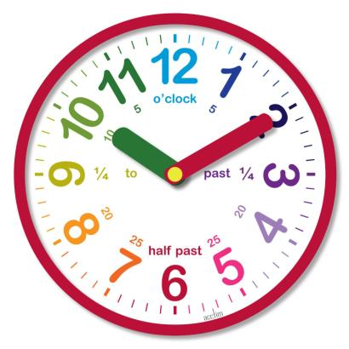

Priority Level of Stimulus
Clock Level
Interrupt Level

Slide 34
Priority Level of Stimulus
Interrupt level – highest priority level. It is allocated to processes which need a very fast response.
Clock level – allocated to periodic processes.

Slide 35


Monitoring & Control Systems
Periodically poll a set of sensors
Issue command to actuator

Slide 36
Monitoring and control systems
Monitoring and control systems are periodically poll a set of sensors, which capture information from the system's environment. They take actions, depending on the sensor readings, by issuing command to actuators.
Let’s discuss the an example of this system Intruder alarm system (diagram) from the textbook

Slide 37
Monitoring & Control Systems
Movement Detector Process
Door Sensor Process
Window Sensor Process
Sensor Status
Detector Status
Alarm System
Building Monitor Process
Communication Process
Power Failure Interrupt
Building Monitor
Room No.
Power Switch Process
Alarm System Process
Alert Message
Room No.
Alarm System
Alarm System
Alarm System
Audible Alarm Process
Voice Synthesizer Process
Lighting Control Process

Slide 38
Monitoring & Control Systems
Real-time system design process with example
There are several stages in the design process for real-time embedded software (alarm system with door sensors, window sensors and motion detector)

Slide 39
Monitoring & Control Systems
Real-time system design process with example
Identify the stimuli that the system must process and the associated responses
Stimuli 🡪 Response
Example:
Stimuli (Intruder Alarm) 🡪 Response (computer room no., call to police, initiate voice synthesizer, switch on audible alarm, switch on light)
Stimuli (power failure) 🡪 Response (switch to backup power)

Slide 40
Monitoring & Control Systems
Real-time system design process with example
For each stimulus and associated response, identify the timing constraints which apply to both stimulus and response processing
Stimuli 🡪 Response
timing

Slide 41
Monitoring & Control Systems
Real-time system design process with example
Stimulus/response | Timing requirement
Power fail interrupt | The switch to backup power must be complete within a deadline of 50 ms
Door alarm | Each door alarm should be polled twice per second
Window alarm | Each window alarm should be polled twice per second
Motion sensor | Each motion sensor should be polled once per second
Audible alarm | The audible alarm should be switched on within 0.5 second
Lights switch | The lights should be switched on within 0.5 second of an alarm being raised by sensor
Communications | The call to the police should be started within 2 seconds of an alarm being raised by a sensor
Voice synthesizer | A synthesized message should be available within 4 seconds of an alarm being raised by a sensor

Slide 42
Monitoring & Control Systems
Real-time system design process with example
Aggregate the stimulus and response processing into a number of concurrent processes
A set of Stimuli 🡪 Response A set of concurrent processes
timing
Example:
Window Sensors 🡪 Window Sensors Process
Door Sensors 🡪 Door Sensors Process
Motion Sensors 🡪 Motion Sensors Process
Notes:
roc

Slide 43
Monitoring & Control Systems
Real-time system design process with example
For each stimulus and response, design algorithms to carry out the required computations
A set of Stimuli 🡪 Response
timing
Computation Algorithm
Notes:
roc

Slide 44
Monitoring & Control Systems
Real-time system design process with example
Design a scheduling system which will ensure that processes are started in time to meet their deadlines
A set of Stimuli 🡪 Response
timing
A set of concurrent processes
Scheduling System
+
Computation Algorithm
Notes:
roc

Slide 45
Monitoring & Control Systems
Real-time system design process with example
Design a scheduling system which will ensure that processes are started in time to meet their deadlines
Time (second) | Action
Every 0.5 sc | Poll door sensor Poll window sensor
Every 1 sc | Poll motion sensor
Notes:
roc

Slide 46
Monitoring & Control Systems
Real-time system design process with example
Integrate the system under the control of a real-time operating system (manages processes and resources allocation such as processor & memory in real-time system)
Notes:
roc

Slide 47
Quiz
Identify ONE stimuli and corresponding/ associated responses for a carpark system.
A carpark system consists of the following hardware:
Sensor
Barrier
Ticket machine
Stimuli (… …) 🡪 Response (… …)

